Slide 1
+ - / * // **
SIMPLE PYTHON CALCULATOR
Do some math with two inputs you entered

Slide 2
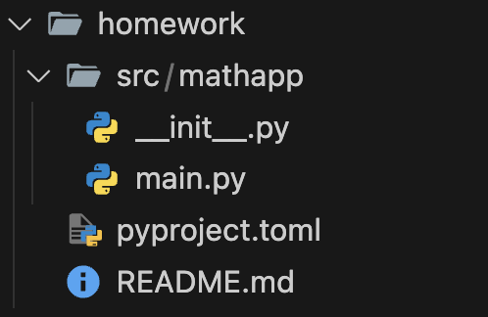
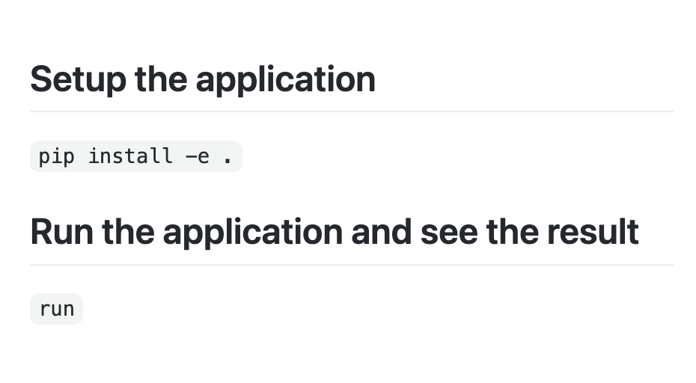
Structure, how I made folders and files
I wanted to make it a simple python package
Pyproject.toml – app specifications
README.md – docs & manuals

Slide 3
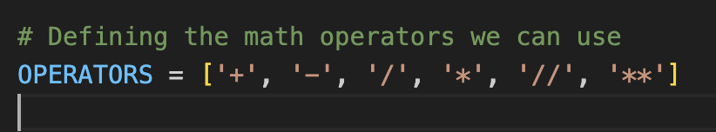
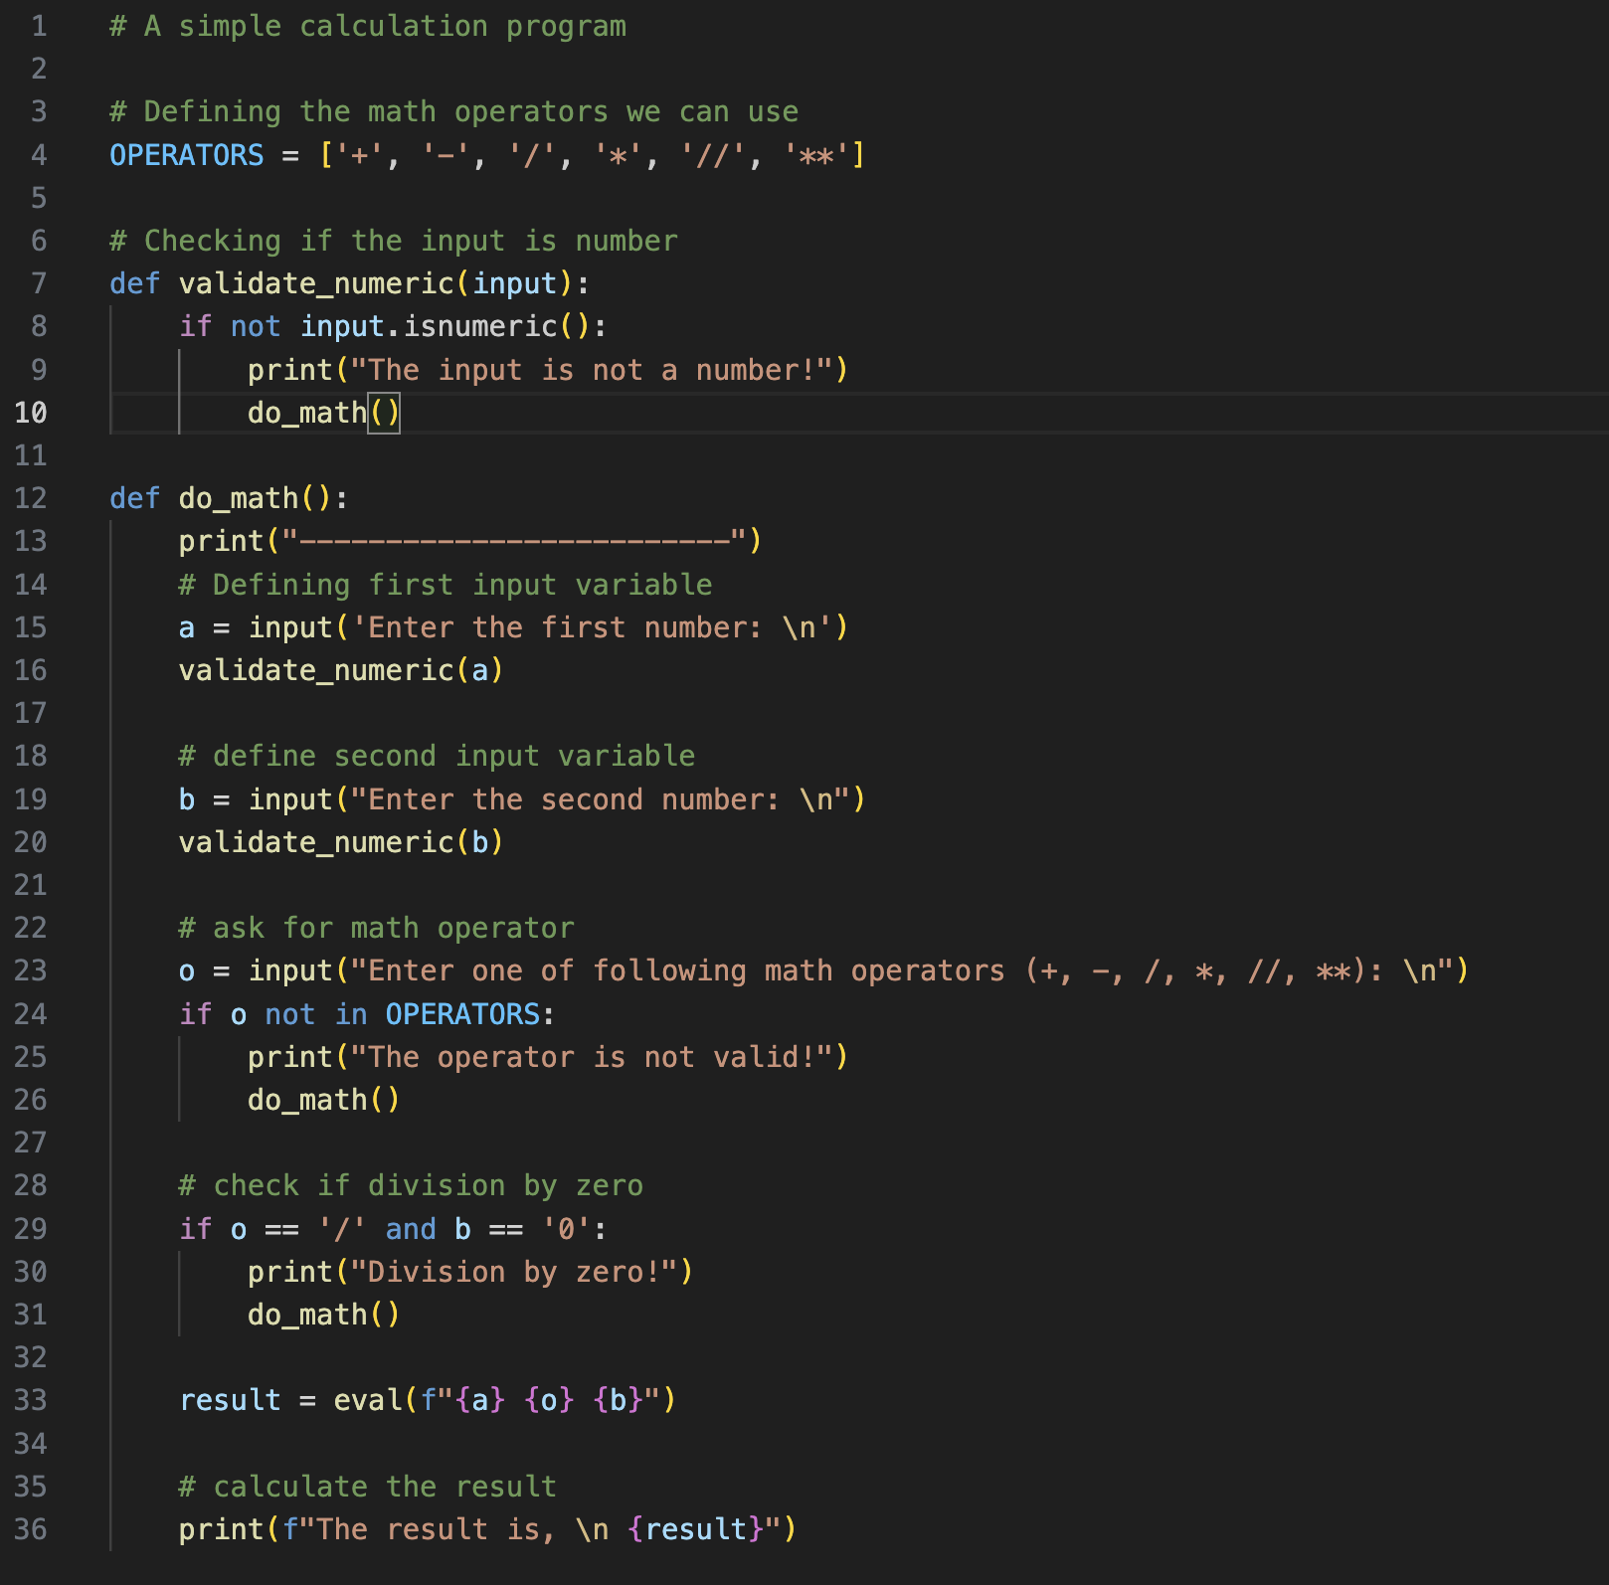
Constants
Clean and understable code
Prevent from accidental changes leading bugs
Change at once
…

Slide 4
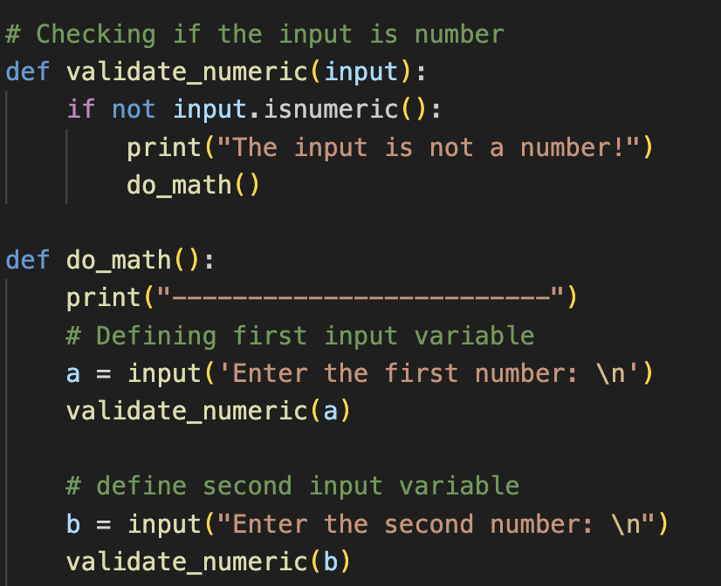
Input Validation
Check first and second input is number or not
Use built-in String.isnumeric() method

Slide 5
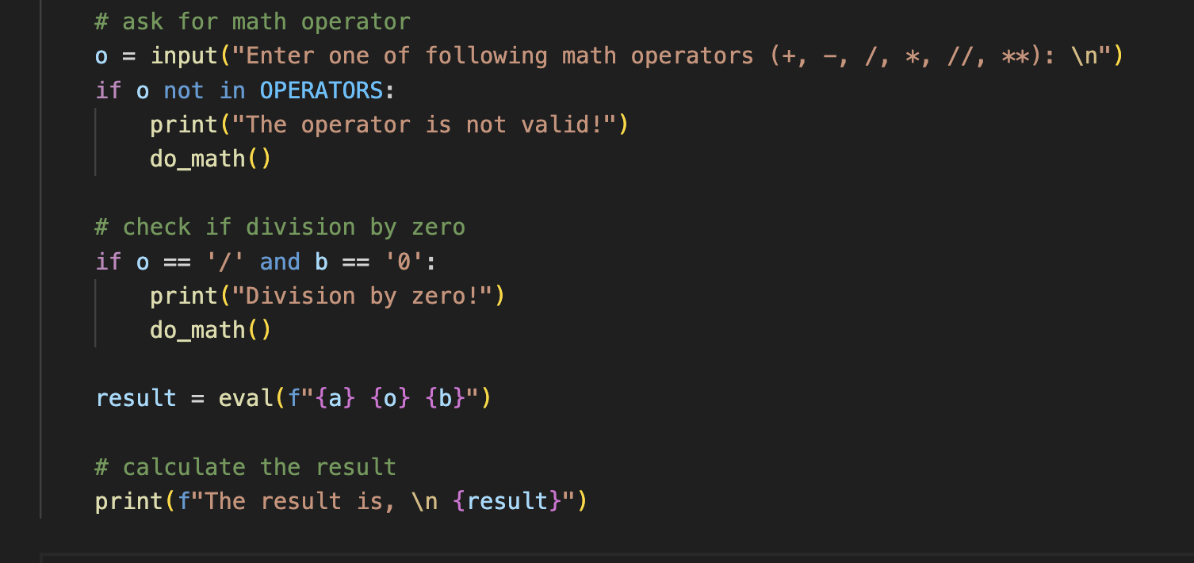
Logic ☺
built-in eval() function in python
print suitable message to user
restart app if validation fails
result at the end

